Slide 1

Building a Culture of Welcome
Recruiting and Retaining Students in Catholic Schools
2024-25 EMT Training Session 3

Slide 2

Building a Culture of Welcome: The Power of Hospitality
“Do not neglect hospitality, for through it some have unknowingly entertained angels.” Hebrews 13:2

Slide 3

Building a Culture of Welcome: The Power of Hospitality
Research shows that a welcoming school environment directly impacts:
  Student enrollment decisions
  Family satisfaction
  Long-term student retention
  Word-of-mouth recommendations
  Overall school community strength

Slide 4

Current Challenges
Increasing educational options for families
Rising costs of private education
Changing demographics in Catholic communities
Competition from charter and other private schools
Need for high-quality staff with an understanding of exceptional hospitality

Slide 5
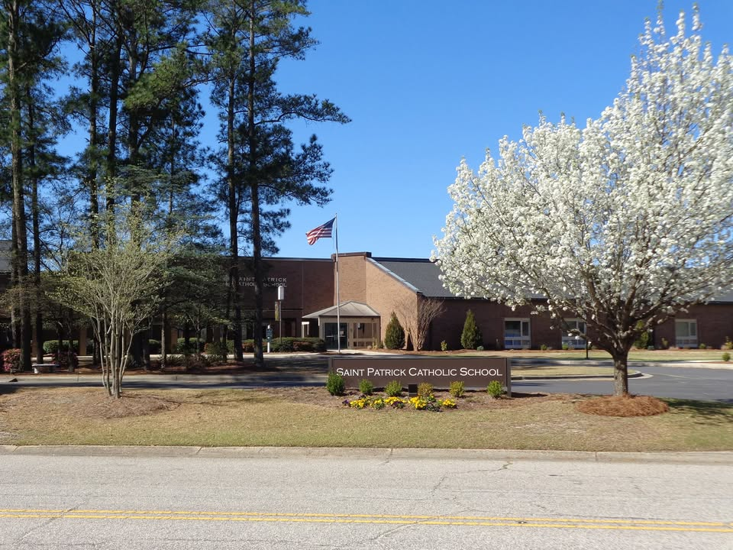
Creating a Culture of Welcome
First Impressions Matter
Warm front office environment
Clear, inviting signage
Prompt response to inquiries
User-friendly website and social media presence

Slide 6
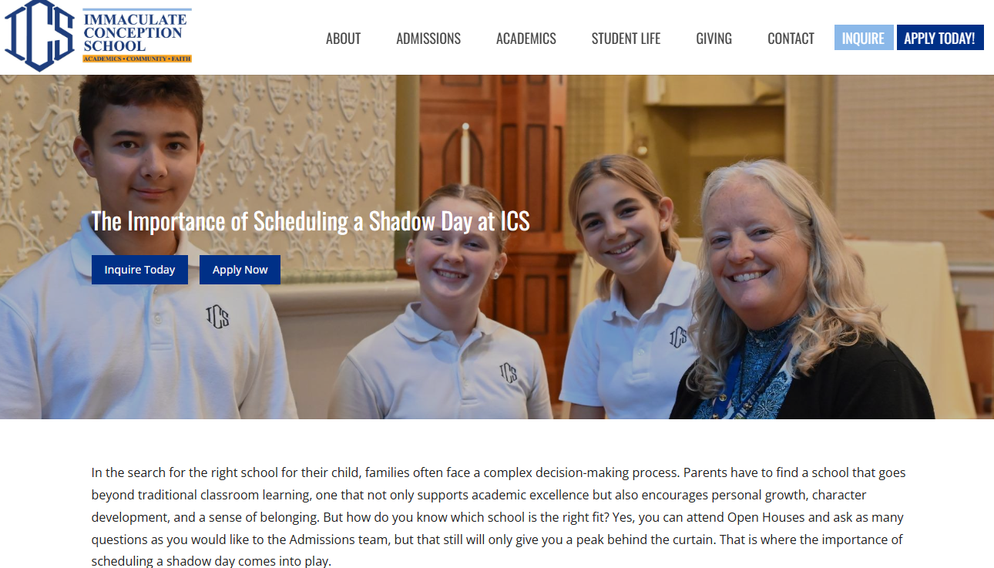
Shadow Day Program
Matched peer buddies
Structured activities
Parent feedback sessions
Follow-up communication plan
https://www.theimmaculate.org/school/the-importance-of-scheduling-a-shadow-day-at-ics/

Slide 7
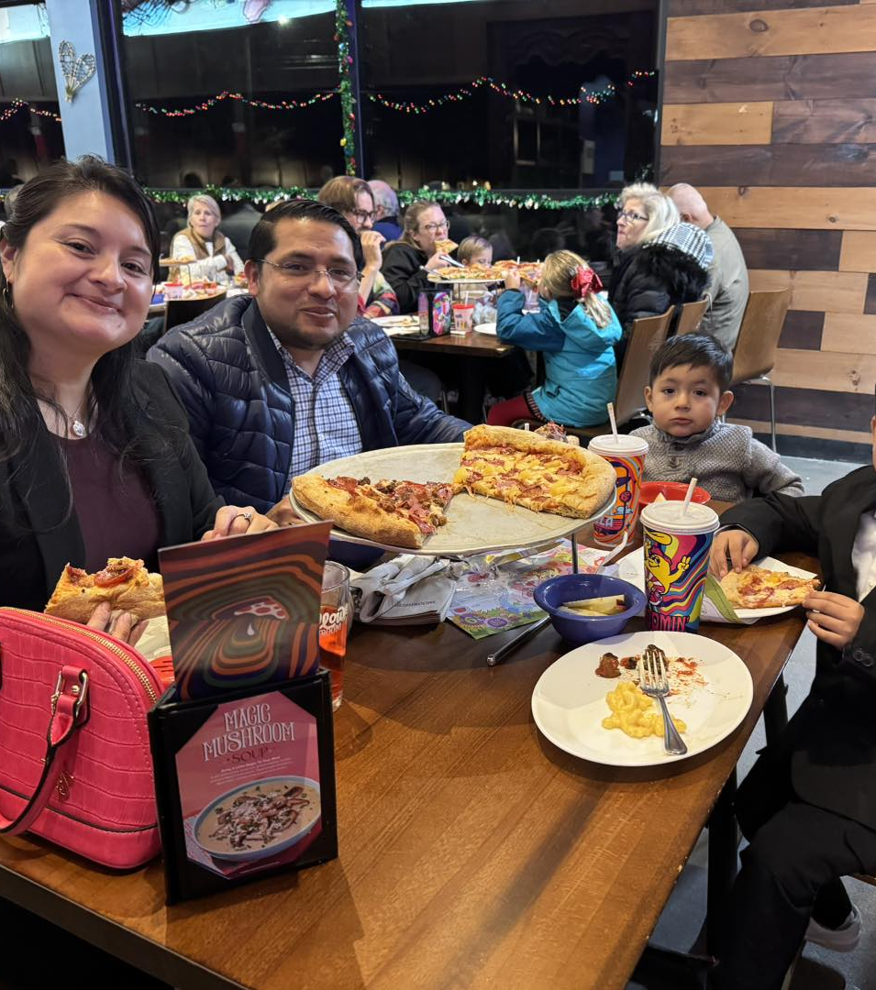
Supporting New Families
Transition Program
New family orientation
Peer family mentoring system
Regular check-ins during first semester
Social events for new families

Slide 8
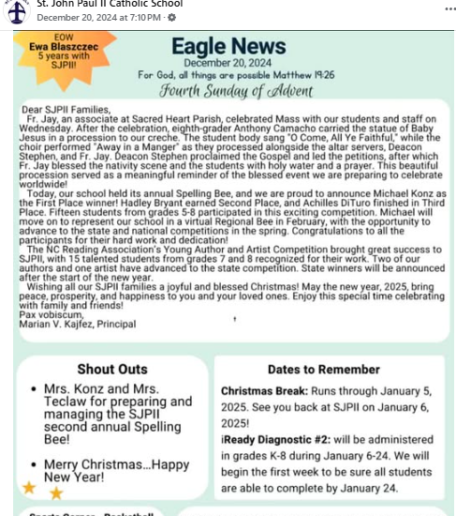
Communication Strategy
Weekly newsletters
Regular parent-teacher contact
Active social media presence
Clear channels for feedback and questions

Slide 9
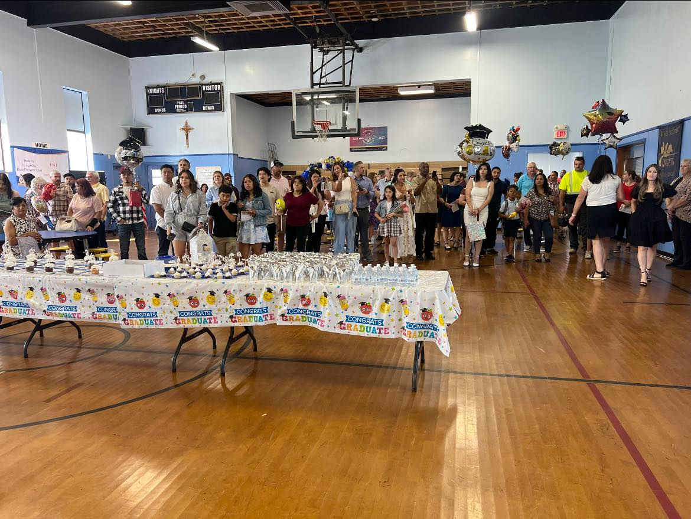
Building Community Engagement
Family Involvement
Volunteer opportunities
Parent ambassador program
Family social events
Cultural celebration days

Slide 10
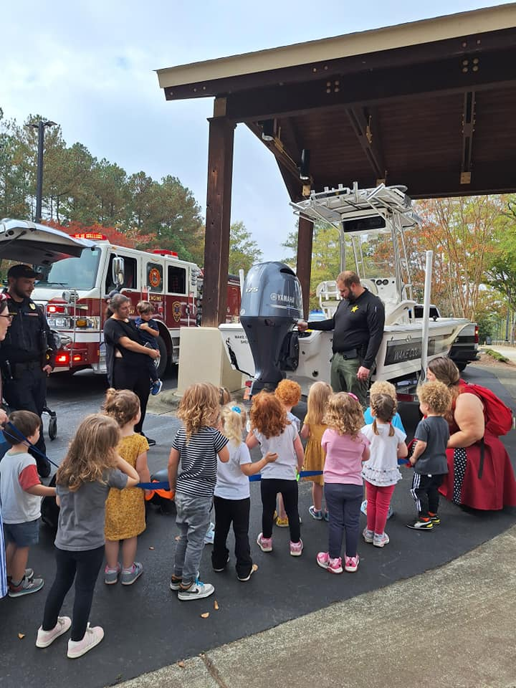
Community Outreach
Parish connection programs
Community service initiatives
Local business partnerships
Alumni engagement

Slide 11
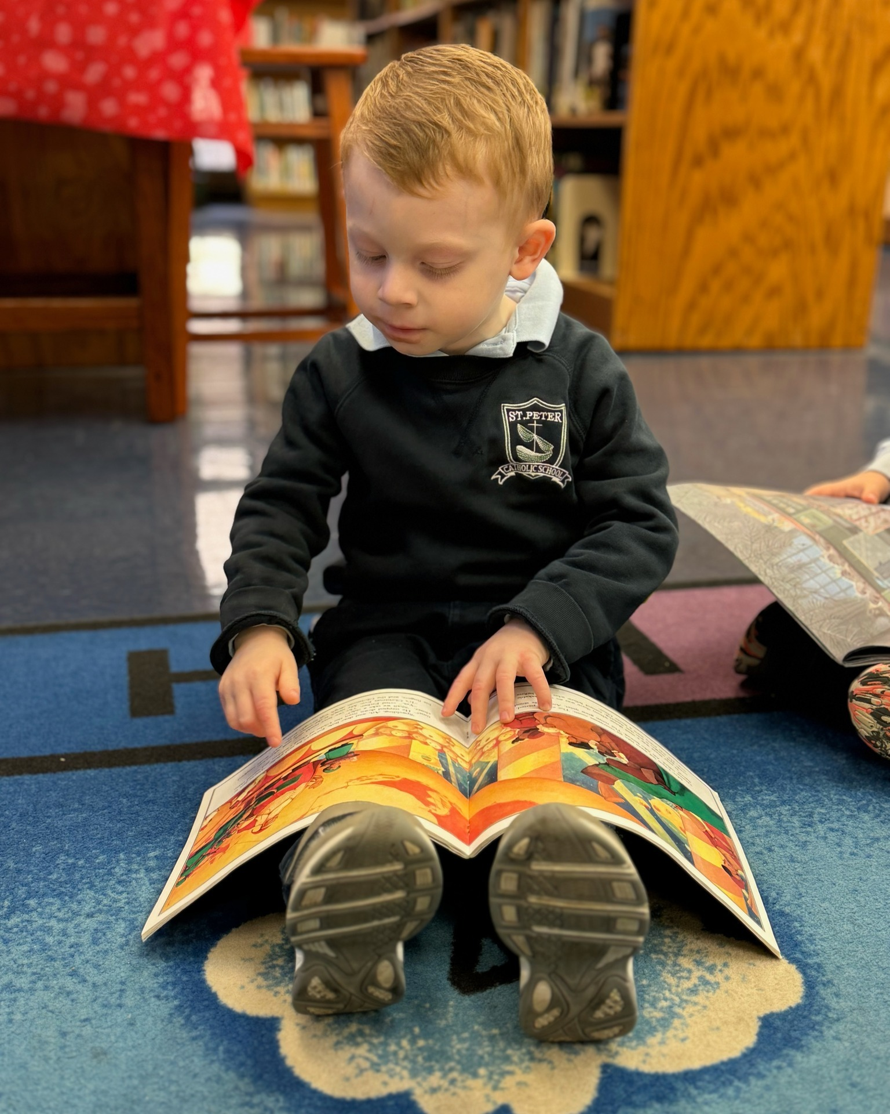
Retention Strategies
Academic Support
Personalized learning plans
Regular progress monitoring
Tutoring programs
Study skills workshops

Slide 12
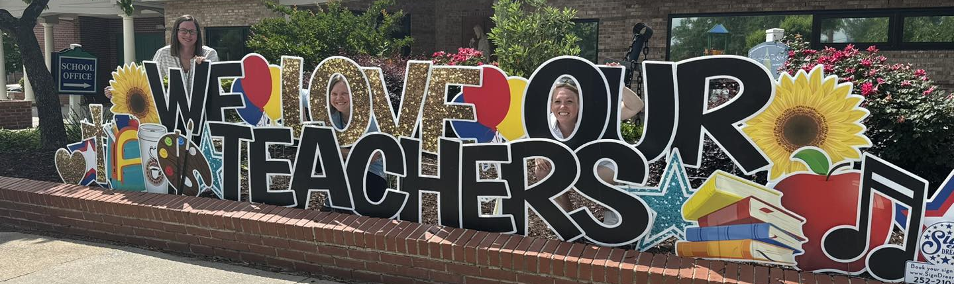
Faculty and Staff Approach
Train staff in cultural competency and inclusive practices
Encourage teachers to practice empathetic listening
Model Christ-like welcome and acceptance
Develop protocols for addressing the needs of diverse learners

Slide 13

Financial Sustainability
Transparent tuition policies
Financial aid guidance
Payment plan options
Scholarship opportunities

Slide 14

Measuring Success
Key Metrics
Enrollment trends
Retention rates
Family satisfaction surveys
Community engagement levels

Slide 15

Continuous Improvement
Regular program evaluation
Parent feedback forums
Staff development
Annual strategic review

Slide 16

Action Steps
Immediate Implementation:
  Assess current welcome procedures
  Train staff in hospitality best practices
  Develop welcome materials
  Launch parent ambassador program
Long-term Goals:
  Build comprehensive welcome program
  Establish measurement systems
  Create sustainable community engagement
  Develop continuous improvement cycle

Slide 17
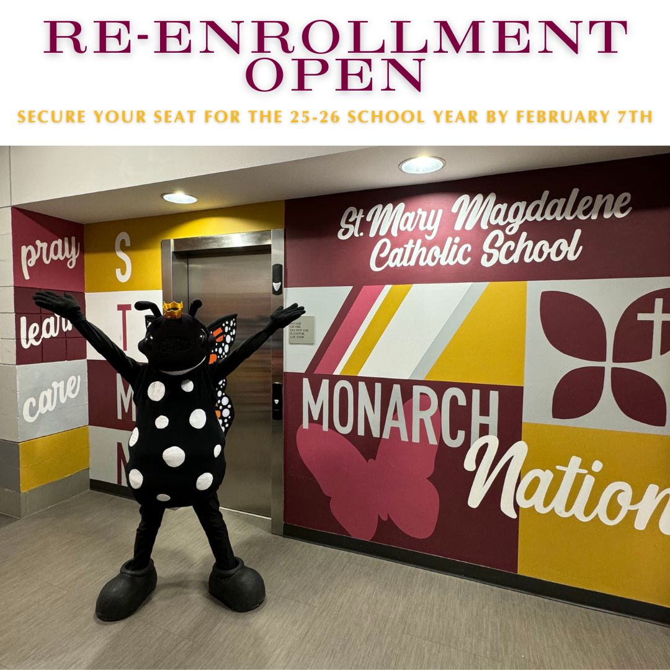
Resources Needed
Personnel
  Dedicated admissions coordinator
  Parent volunteer coordinators
  Student ambassadors
  Faculty mentors
Materials
  Welcome packets
  Marketing materials
  Communication templates
  Training resources

Slide 18

Expected Outcomes
Short-term
  Increased inquiry-to-enrollment conversion
  Higher family satisfaction ratings
  Improved communication effectiveness
  Stronger community engagement
Long-term
  Sustained enrollment growth
  Enhanced school reputation
  Stronger financial stability
  Thriving school community

Slide 19
Questions for Discussion
How can we better understand our families' needs?
What unique aspects of our school can we highlight?
How can we empower our current families as ambassadors?
What resources do we need to implement these strategies?

