Slide 1
Welcome Principals, Directors and Enrollment Management Team Members

Slide 2
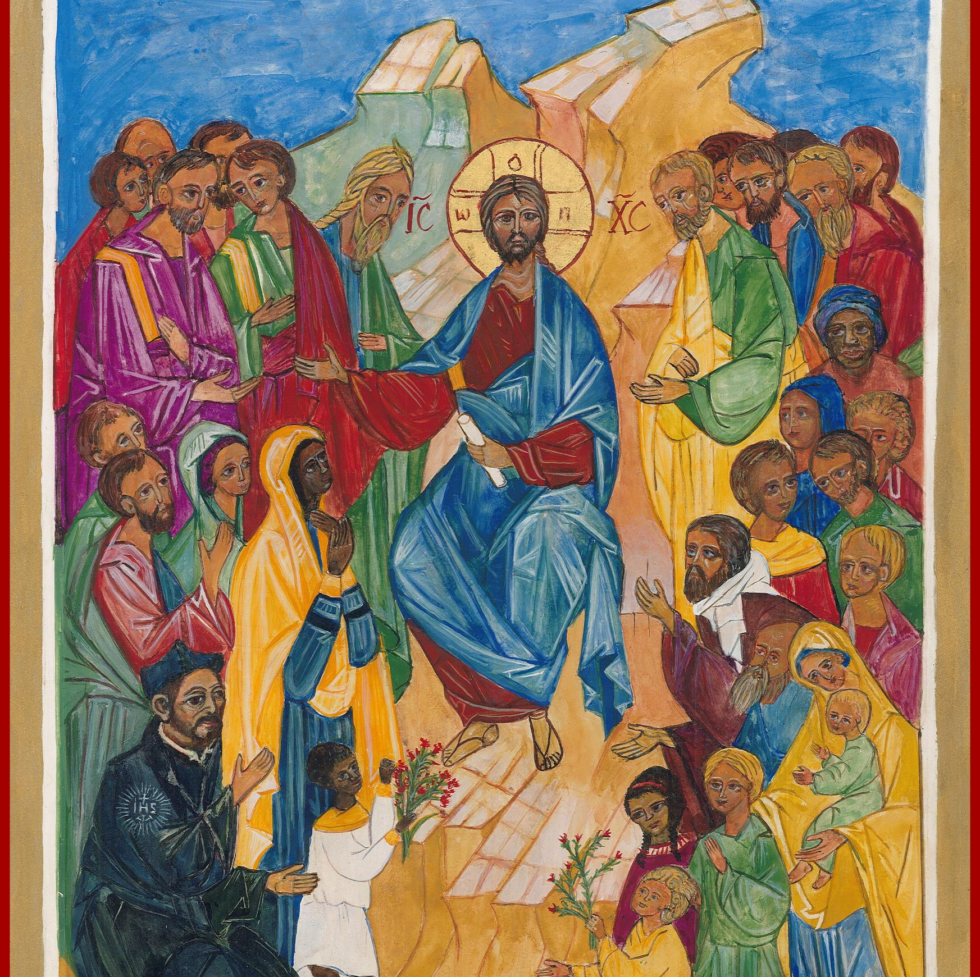
Prayer
Almighty God,
You sent forth your Son as a beacon of hope for all people.
As a Teacher, He has given us the prime example of the importance of education. As disciples, we look to him for inspiration and strength.
Thank you for the many people who have dedicated their lives in service to our Catholic Schools.
Thank you for the teachers and administrators who sustain our schools.
Thank you for the parents who have given support and witness to the importance of Catholic education.
Bless all our Catholic Schools and the many people who advance our mission.
May our schools be a home for those who seek to grow in openness, faith, love, intellect and commitment to justice.
In the name of the Father, and of the Son, and of the Holy Spirit, Amen.
Notes:
Prayer before Meetings
Heavenly Father, as we enter into this meeting, we bring your presence with us. We speak your peace, your grace, your mercy, and your perfect order. We acknowledge your power over all that will be spoken, thought, discussed, decided, and done during our meeting.
Lord, we thank you for the gifts you have given to us and we commit to using them responsibly in your honor. Give us a fresh supply of strength and compassion to do our job. Anoint our plans, ideas, and energies so that even our smallest accomplishment may bring you glory.
Lord, when we are confused, guide us, when we are anxious, comfort us, and when we are tired, infuse with the fire of the Holy Spirit.
May the work that we do and the way we do it bring faith, joy, and hope to all of those we serve today and every day.
We ask this through your son, Jesus Christ.
Amen.

Slide 3
Enrollment Management Team Training Session 1: Overview of EMTs, Preparing for Fall Enrollment and Admissions 2024-25

Slide 4
Our Learning Goal… Enrollment Management Teams
Enrollment Management Team
Members will be able to…
Celebrate current strengths and powerful practices in enrollment
Identify opportunities for growth
Implement immediate steps to recruit and retain students and families

Slide 5
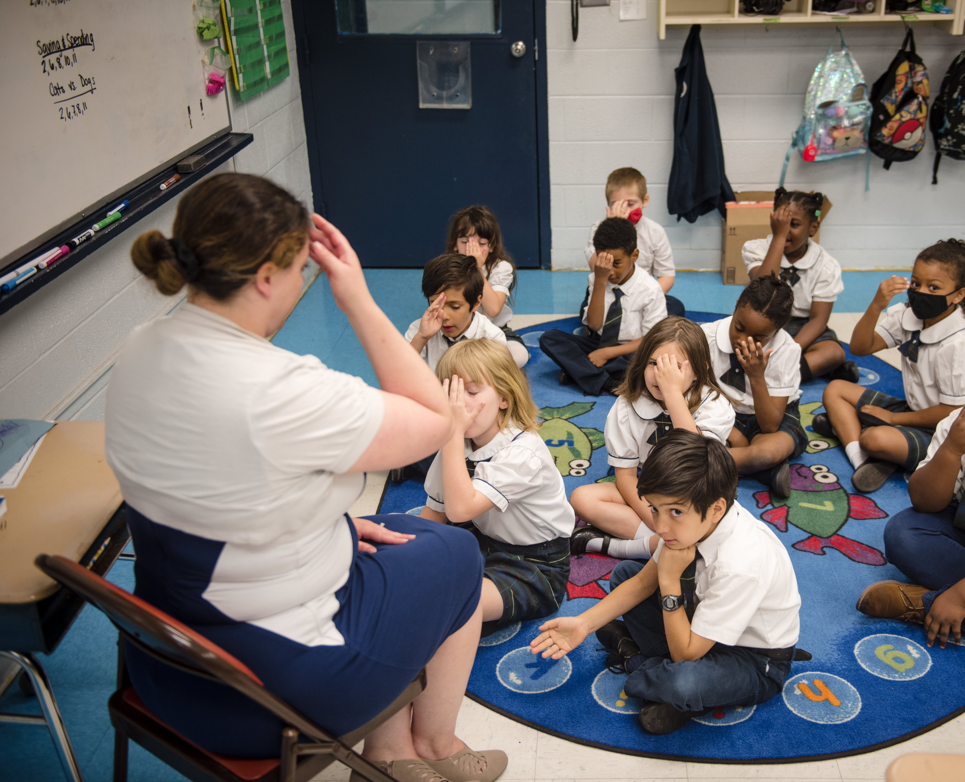
OPERATIONAL VITALITY Enrollment Management Teams
One day we will:
Be accessible to and inclusive of any student regardless of socio-economic status, race, cultural background, religious affiliation or learning exceptionality.
We will retain and attract students so that every seat in every classroom in every school will be filled.

Slide 6
OPERATIONAL VITALITY Enrollment Management Meetings and Topics
Wed. Nov. 6 10-11am Planning for Catholic Schools Week / Retaining Current Families
Wed. Jan. 15 10-11am Why Choose Catholic Schools? Hospitality and Welcoming
Wed. March 19 10-11am Why Choose Catholic Schools? Academic Excellence

Slide 7
OPERATIONAL VITALITY Enrollment Management Training - Questions
One day we will:
Be accessible to and inclusive of any student regardless of socio-economic status, race, cultural background, religious affiliation or learning exceptionality.
We will retain and attract students so that every seat in every classroom in every school will be filled.

Slide 8
Overview of Enrollment Management Teams

Slide 9
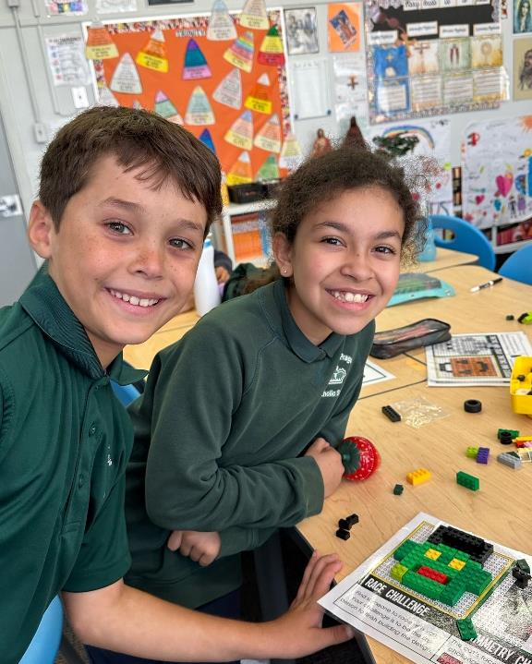
Role of Enrollment Management
Have a clear vision
Provide the budgetary resources for success
Host team meetings frequently and consistently
Establish a master calendar
Evaluate, assess, and improve
Gather data and understand what the data is indicating
Perfect the art of customer service

Slide 10
The “virtuous circle” of Enrollment Management

Slide 11
Team Member Roles
Principal
Leader
Technical Advisor
Treasurer
Evangelizer
Public Relations/Marketing Expert
Finance Expert
A Stellar Teacher
Organizer

Slide 12
Embracing Fall Enrollment: Meeting goals for Catholic school admissions

Slide 13
Poll: When does your application period open?

Slide 14
Benefits of Fall Enrollment
Aligns with public school schedules: Easier for families transitioning from public schools
Allows for better financial planning: Families have more time to arrange tuition payments
Increases competitiveness: Matches timeline of other private schools
Improves student preparation: More time for new students to prepare for transition
Enhances school planning: Earlier knowledge of class sizes for staffing decisions

Slide 15
Aligns with Public School Schedules
Matches the typical decision-making timeline for education
Eases transition for families coming from public schools
Allows for a more natural flow in the education calendar

Slide 16
Allows for Better Financial Planning
Families have more time to arrange tuition payments
Opportunity to save over summer months
Aligns with many parents' fiscal year-end bonuses or raises

Slide 17
Increases Competitiveness
Matches timeline of other private schools
Prevents losing potential students to schools with earlier enrollment
Allows for competitive comparison of programs and costs

Slide 18
Improves Student Preparation
More time for new students to prepare for transition
Summer months can be used for
School visits
Meeting teachers
Acquiring necessary materials and uniforms

Slide 19
Enhances School Planning
Earlier knowledge of class sizes for
Staffing decisions
Resource allocation
Curriculum planning
More time to adjust programs based on enrollment numbers

Slide 20
Implementation Strategies
Gradual transition over 2-3 years
Clear communication with current and prospective families
Collaboration with local Catholic school networks
Development of fall open house and tour schedules

Slide 21
Fall Enrollment Events
Open House Days
Showcase facilities and meet staff
Interactive demos of programs
Student Shadow Days
Prospective students experience a school day
Pair with current student ambassadors
Community Service Projects
Demonstrate school values in action
Invite community participation
Academic Competitions
Showcase student achievements
Invite prospective students to participate
Parent Information Nights
Address concerns and questions
Present on curriculum and school culture

Slide 22
Fall Enrollment Events

Slide 23
Resources for EMTs

Slide 24
Marketing and Enrollment Resources
Partners in Mission: https://www.partnersinmission.com/
National Catholic Educational Association (NCEA)Website: https://www.ncea.org/
Finalsite: https://www.finalsite.com/blog
Cursive Content: https://cursivecontent.com/
Social School 4 EDU: https://socialschool4edu.com/

Slide 25
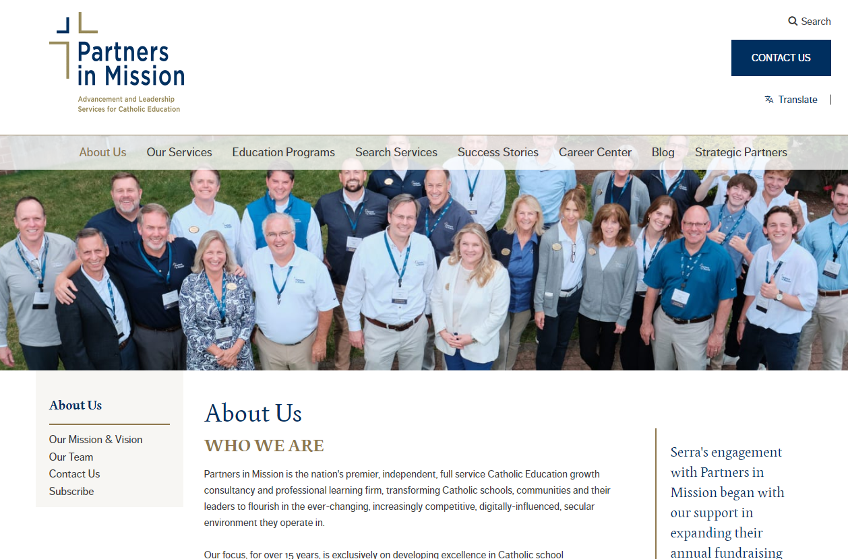
Marketing and Enrollment Resources
Partners in Mission: https://www.partnersinmission.com/

Slide 26
Marketing and Enrollment Resources
National Catholic Educational Association (NCEA)Website: https://www.ncea.org/

Slide 27
Marketing and Enrollment Resources
Finalsite: https://www.finalsite.com/blog

Slide 28
Marketing and Enrollment Resources
Cursive Content: https://cursivecontent.com/

Slide 29
Marketing and Enrollment Resources
Social School 4 EDU: https://socialschool4edu.com/resources/

Slide 30
Prayer
Loving God,
You are present to us whenever we gather as a faith community.
We pray that our schools will be places where everyone feels accepted, safe, and beloved.
Help our schools and our local communities be places of faith so that we can help others believe in You.
Fill us with Your Spirit so that we may reflect Your light and love to each other and the whole world as one Body of Christ.
Amen.
Notes:
Prayer before Meetings
Heavenly Father, as we enter into this meeting, we bring your presence with us. We speak your peace, your grace, your mercy, and your perfect order. We acknowledge your power over all that will be spoken, thought, discussed, decided, and done during our meeting.
Lord, we thank you for the gifts you have given to us and we commit to using them responsibly in your honor. Give us a fresh supply of strength and compassion to do our job. Anoint our plans, ideas, and energies so that even our smallest accomplishment may bring you glory.
Lord, when we are confused, guide us, when we are anxious, comfort us, and when we are tired, infuse with the fire of the Holy Spirit.
May the work that we do and the way we do it bring faith, joy, and hope to all of those we serve today and every day.
We ask this through your son, Jesus Christ.
Amen.

