Slide 1

Enrollment Management
2023-24
Session 3: Enrollment Management for Operational Vitality

Slide 2
Welcome Principals, Directors and Enrollment Management Team Members

Slide 3

Prayer
Almighty God,
You sent forth your Son as a beacon of hope for all people.
As a Teacher, He has given us the prime example of the importance of education. As disciples, we look to him for inspiration and strength.
Thank you for the many people who have dedicated their lives in service to our Catholic Schools.
Thank you for the teachers and administrators who sustain our schools.
Thank you for the parents who have given support and witness to the importance of Catholic education.
Thank you for the students who work hard to further their education. Bless all our Catholic Schools and the many people who advance our mission.
May our schools be a home for those who seek to grow in openness, faith, love, intellect and commitment to justice.
In your name, we pray. Amen.
Notes:
Prayer before Meetings
Heavenly Father, as we enter into this meeting, we bring your presence with us. We speak your peace, your grace, your mercy, and your perfect order. We acknowledge your power over all that will be spoken, thought, discussed, decided, and done during our meeting.
Lord, we thank you for the gifts you have given to us and we commit to using them responsibly in your honor. Give us a fresh supply of strength and compassion to do our job. Anoint our plans, ideas, and energies so that even our smallest accomplishment may bring you glory.
Lord, when we are confused, guide us, when we are anxious, comfort us, and when we are tired, infuse with the fire of the Holy Spirit.
May the work that we do and the way we do it bring faith, joy, and hope to all of those we serve today and every day.
We ask this through your son, Jesus Christ.
Amen.

Slide 4
Enrollment Management Team Training
Session 3
2023-24

Slide 5

Our Learning Goal…
Enrollment Management Teams
Enrollment Management Team
Members will be able to…
Celebrate current strengths and powerful practices in enrollment
Identify opportunities for growth
Implement immediate steps to recruit and retain students and families

Slide 6

OPERATIONAL VITALITY
Enrollment Management Teams
One day we will:
Be accessible to and inclusive of any student regardless of socio-economic status, race, cultural background, religious affiliation or learning exceptionality.
We will retain and attract students so that every seat in every classroom in every school will be filled.

Slide 7
Enrollment Management for Operational Vitality
Operational Vitality in Catholic Schools
Enrollment Management
Data Informed Decision Making in Enrollment Management
Strategic Communications for Enrollment

Slide 8
Operational Vitality in Catholic Schools

Slide 9

Defining Operational Vitality
Catholic schools must adopt and maintain standards for operational vitality in these areas and define the norms and expectations for fundamental procedures to support and ensure viability and sustainability.
When a school does not maintain standards for operational vitality, the continuation of academic excellence is in grave jeopardy.
Over time, even an academically rigorous school with strong Catholic identity will not survive without operational vitality.
(NATIONAL STANDARDS AND BENCHMARKS FOR EFFECTIVE CATHOLIC ELEMENTARY AND SECONDARY SCHOOLS)

Slide 10
How can enrollment and admissions support Operational Vitality
Podcast: “Because of You” https://mcdn.podbean.com/mf/download/bj3vss/042723-Because-of-You.mp3
NCEA resources: https://ncea.org/NCEA/NCEA/How_We_Serve/Resources/Operational_Vitality_Resources.aspx

Slide 11

Sources of Revenue
Enrollment Management
Special Events
Annual Fund
Major Gifts
Capital Campaign
Planned Giving

Slide 12
Enrollment Management

Slide 13
Enrollment Management – Core Competencies
Have a clear vision.
Provide the budgetary resources for success.
Host team meetings frequently and consistently.
Establish a master calendar.
Evaluate, assess, and improve.
Gather data and understand what the data is indicating.
Perfect the art of customer service.

Slide 14
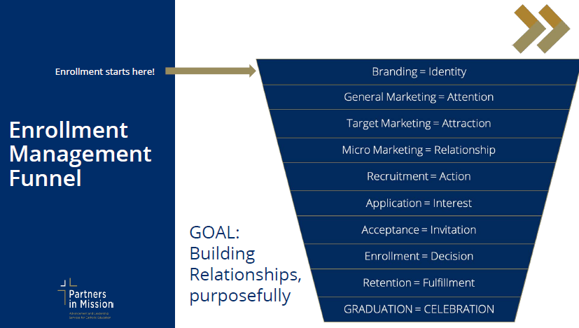
Enrollment Management – Core Competencies

Slide 15
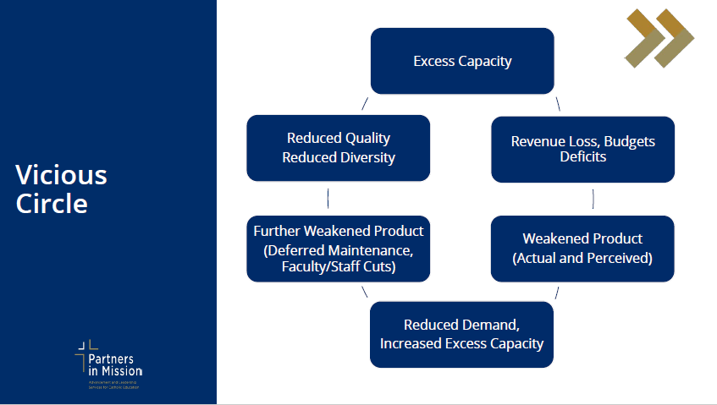
Enrollment Management – Core Competencies

Slide 16
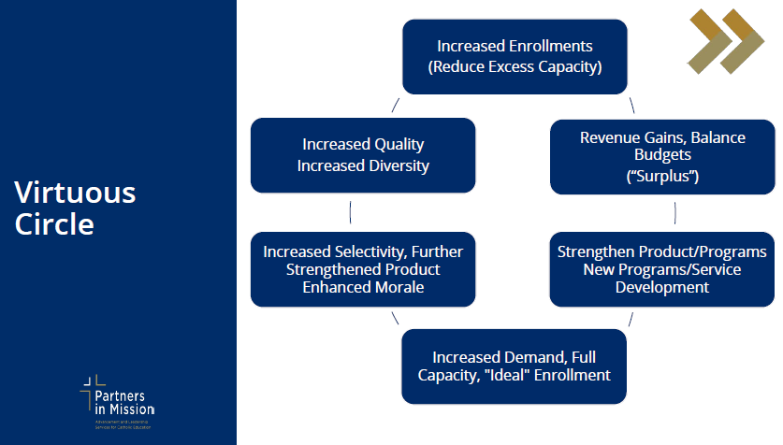
Enrollment Management – Core Competencies

Slide 17
Data Informed Decision Making in Enrollment Management

Slide 18
Data Informed Decision Making for Enrollment
If you can’t measure it, you can’t manage improve it.

Slide 19
Sources of Enrollment Management Data
1. Parish and partner school data
2. Admissions funnel data
3. Enrollment data
4. Survey, survey, survey

Slide 20
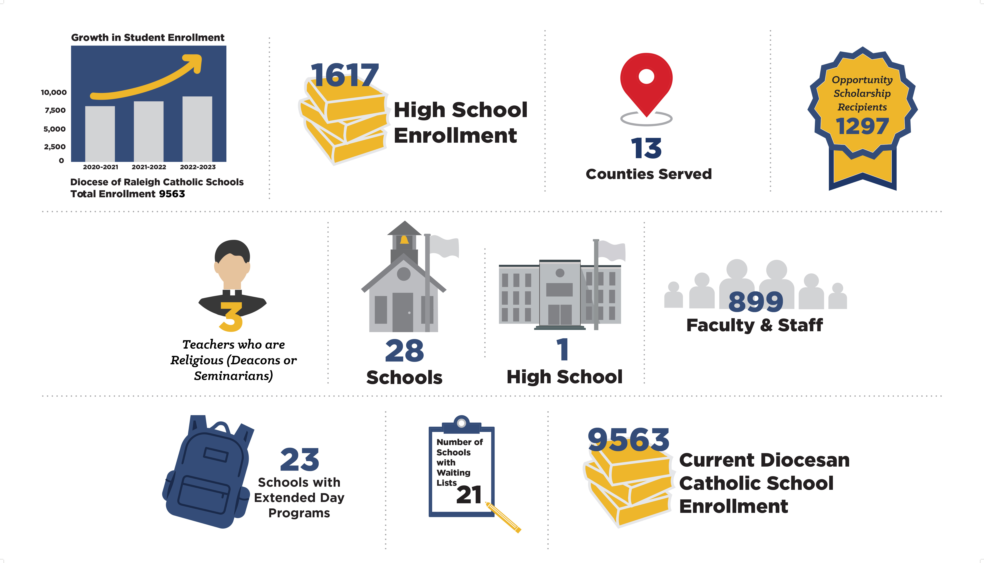
How are you tracking your enrollment data?

Slide 21
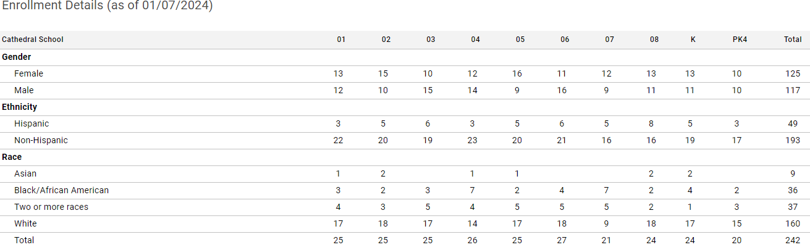
Capturing ALL Data
Using FACTS SIS
Request your school’s DART reports from OOE
Multi-year tracking

Slide 22
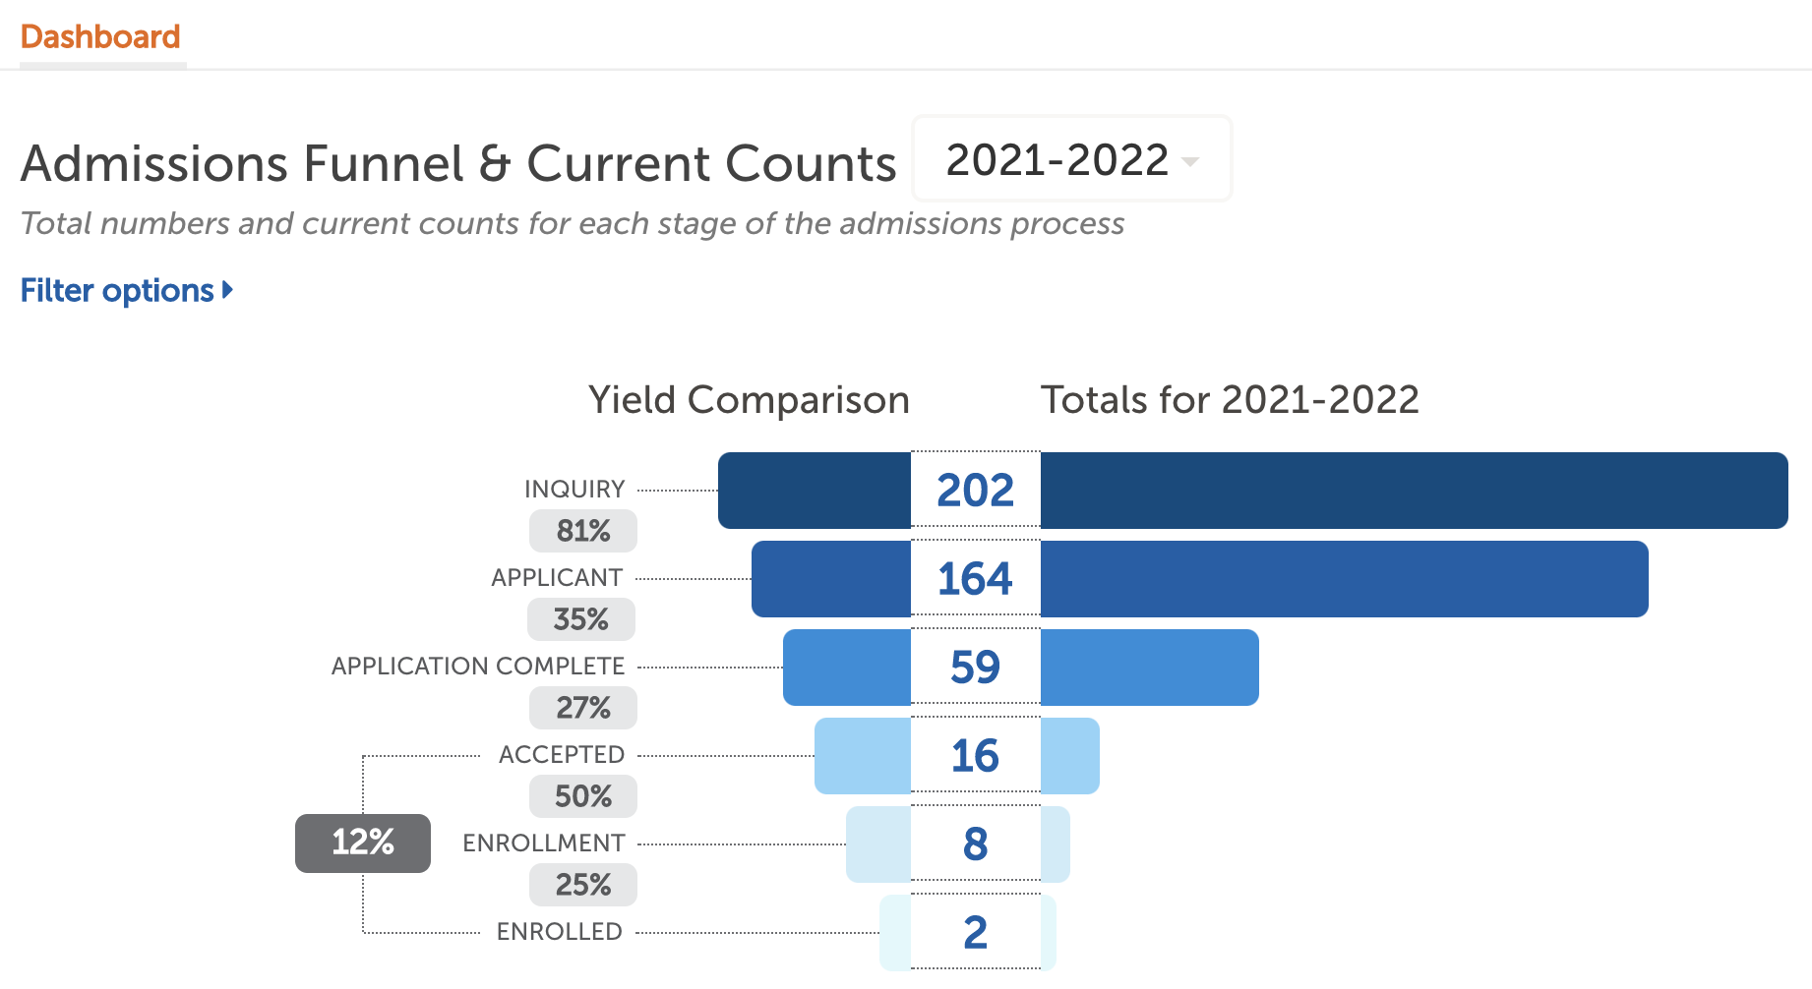
Admissions Funnel Statistics
FACTS SIS or Excel Spreadsheet
  Inquiry
  Tour
  Application
  Offer of Admission
  Accepted
  Enrolled
Note: Gather data by month for year-to-year comparisons

Slide 23
Surveys for Enrollment Management Data
•Why are families choosing your school?
•Why are families choosing other schools?

Slide 24
Surveys for Enrollment Management Data
Current Family Survey Questions
• When did you start researching
schools?
• What marketing channels were most
effective?
• What factors were most influential
when choosing?
• How important was the shadow
experience/open house?
• How were your interactions with the
admissions office/staff?
• Comments…
Families who did not register
• Where will your child be attending?
• What marketing channels were most
effective?
• Rate the areas compared to the
school your child will attend?
• How important was the shadow
experience/open house?
• How were your interactions with the
admissions office/staff?
• What could we have done better?
• Comments…

Slide 25

Calculating Class Sizes and Open Seats
Educational best practices
Parental expectations
Physical space limitations
Other competing schools

Slide 26
Strategic Communications for Enrollment

Slide 27
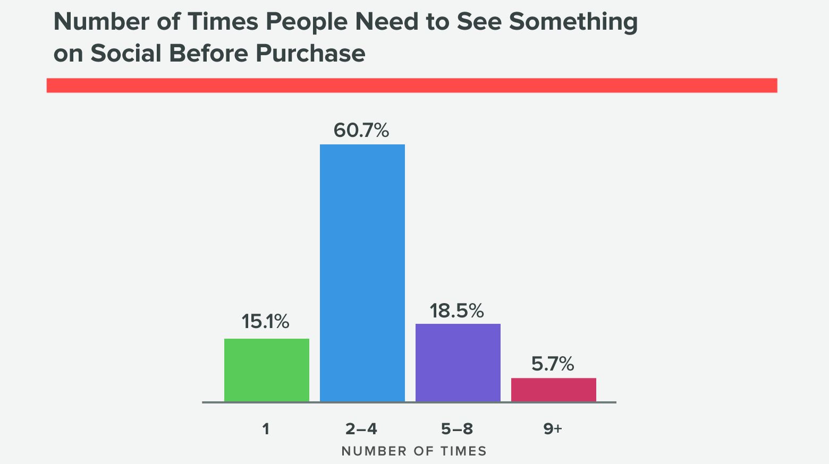
Strategic Communications for Enrollment
Strategic communications are vital for
  Recruitment
  Retention

Slide 28

Strategic Communications for Enrollment
• Effectively convey our school's unique value
proposition
• Engage with the community
• Share the Good News of Catholic education
• Dispel misconceptions
• Build trust
• Nurture positive relationships with prospective
families

Slide 29

Messaging to Accomplish Enrollment Goals
Focus on key entry points (preschool, KG, 6th Grade)
Highlight “opportunities” – openings in a specific grade
Word of mouth – generate excitement in your community

Slide 30
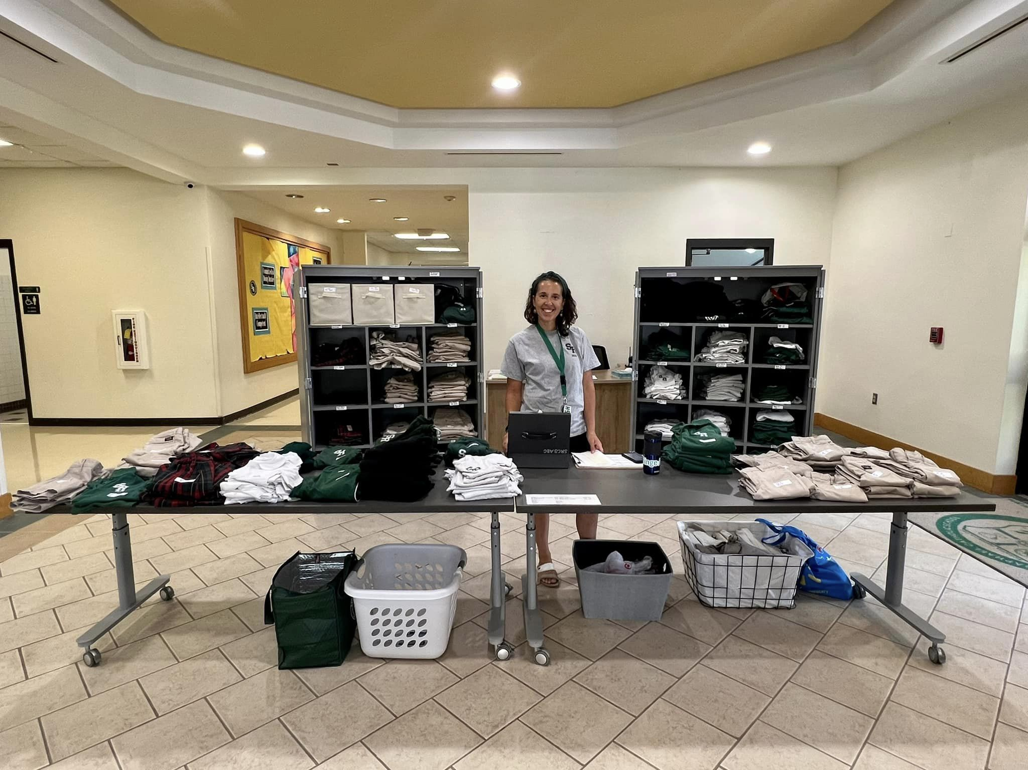
Customer Service - Make it personal and remarkable!
In-Person
Phone
  Smile – Outgoing Message –Voicemail – School Reach Email
  Native example – Autoresponder –Closing and Signature
Website: Interactivity
Social Media: Engagement

Slide 31

OPERATIONAL VITALITY
Enrollment Management Meetings and Topics
Wed. March 13, 10-11am Social Media Marketing

Slide 32
OPERATIONAL VITALITY
Enrollment Management Training - Questions
One day we will:
Be accessible to and inclusive of any student regardless of socio-economic status, race, cultural background, religious affiliation or learning exceptionality.
We will retain and attract students so that every seat in every classroom in every school will be filled.

Slide 33
Prayer
Loving God,
You are present to us whenever we gather as a faith community.
We pray that our schools will be places where everyone feels accepted, safe, and beloved.
Help our schools and our local communities be places of faith so that we can help others believe in You.
Fill us with Your Spirit so that we may reflect Your light and love to each other and the whole world as one Body of Christ.
We ask this of Jesus, Your Son, who lives and reigns with You, in the unity of the Holy Spirit, one God, forever and ever.
Amen.
Notes:
Prayer before Meetings
Heavenly Father, as we enter into this meeting, we bring your presence with us. We speak your peace, your grace, your mercy, and your perfect order. We acknowledge your power over all that will be spoken, thought, discussed, decided, and done during our meeting.
Lord, we thank you for the gifts you have given to us and we commit to using them responsibly in your honor. Give us a fresh supply of strength and compassion to do our job. Anoint our plans, ideas, and energies so that even our smallest accomplishment may bring you glory.
Lord, when we are confused, guide us, when we are anxious, comfort us, and when we are tired, infuse with the fire of the Holy Spirit.
May the work that we do and the way we do it bring faith, joy, and hope to all of those we serve today and every day.
We ask this through your son, Jesus Christ.
Amen.

