Slide 1

Welcome Principals, Directors and Enrollment Management Team Members

Slide 2
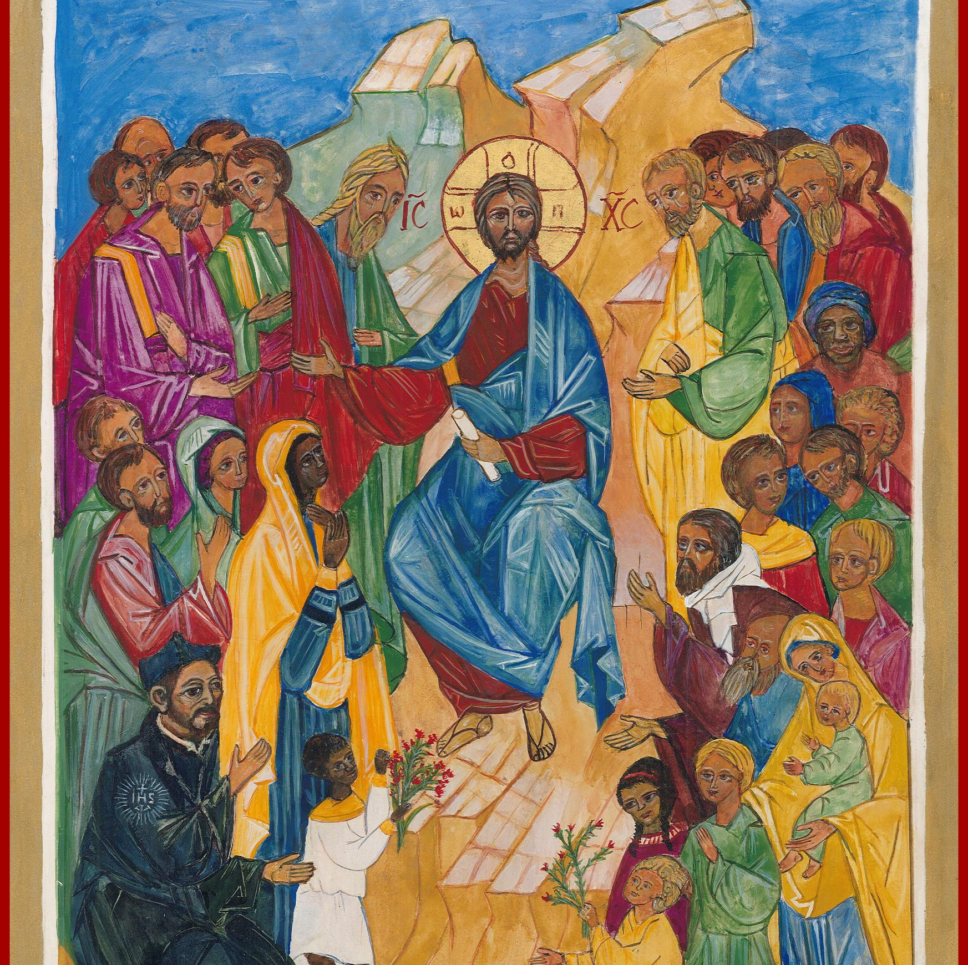
Prayer
Almighty God,
You sent forth your Son as a beacon of hope for all people.
As a Teacher, He has given us the prime example of the importance of education. As disciples, we look to him for inspiration and strength.
Thank you for the many people who have dedicated their lives in service to our Catholic Schools.
Thank you for the teachers and administrators who sustain our schools.
Thank you for the parents who have given support and witness to the importance of Catholic education.
Thank you for the students who work hard to further their education. Bless all our Catholic Schools and the many people who advance our mission.
May our schools be a home for those who seek to grow in openness, faith, love, intellect and commitment to justice.
In your name, we pray. Amen.
Notes:
Prayer before Meetings
Heavenly Father, as we enter into this meeting, we bring your presence with us. We speak your peace, your grace, your mercy, and your perfect order. We acknowledge your power over all that will be spoken, thought, discussed, decided, and done during our meeting.
Lord, we thank you for the gifts you have given to us and we commit to using them responsibly in your honor. Give us a fresh supply of strength and compassion to do our job. Anoint our plans, ideas, and energies so that even our smallest accomplishment may bring you glory.
Lord, when we are confused, guide us, when we are anxious, comfort us, and when we are tired, infuse with the fire of the Holy Spirit.
May the work that we do and the way we do it bring faith, joy, and hope to all of those we serve today and every day.
We ask this through your son, Jesus Christ.
Amen.

Slide 3
Enrollment Management Team Training
Session 1
2023-24

Slide 4

Our Learning Goal…
Enrollment Management Teams
Enrollment Management Team
Members will be able to…
Celebrate current strengths and powerful practices in enrollment
Identify opportunities for growth
Implement immediate steps to recruit and retain students and families

Slide 5
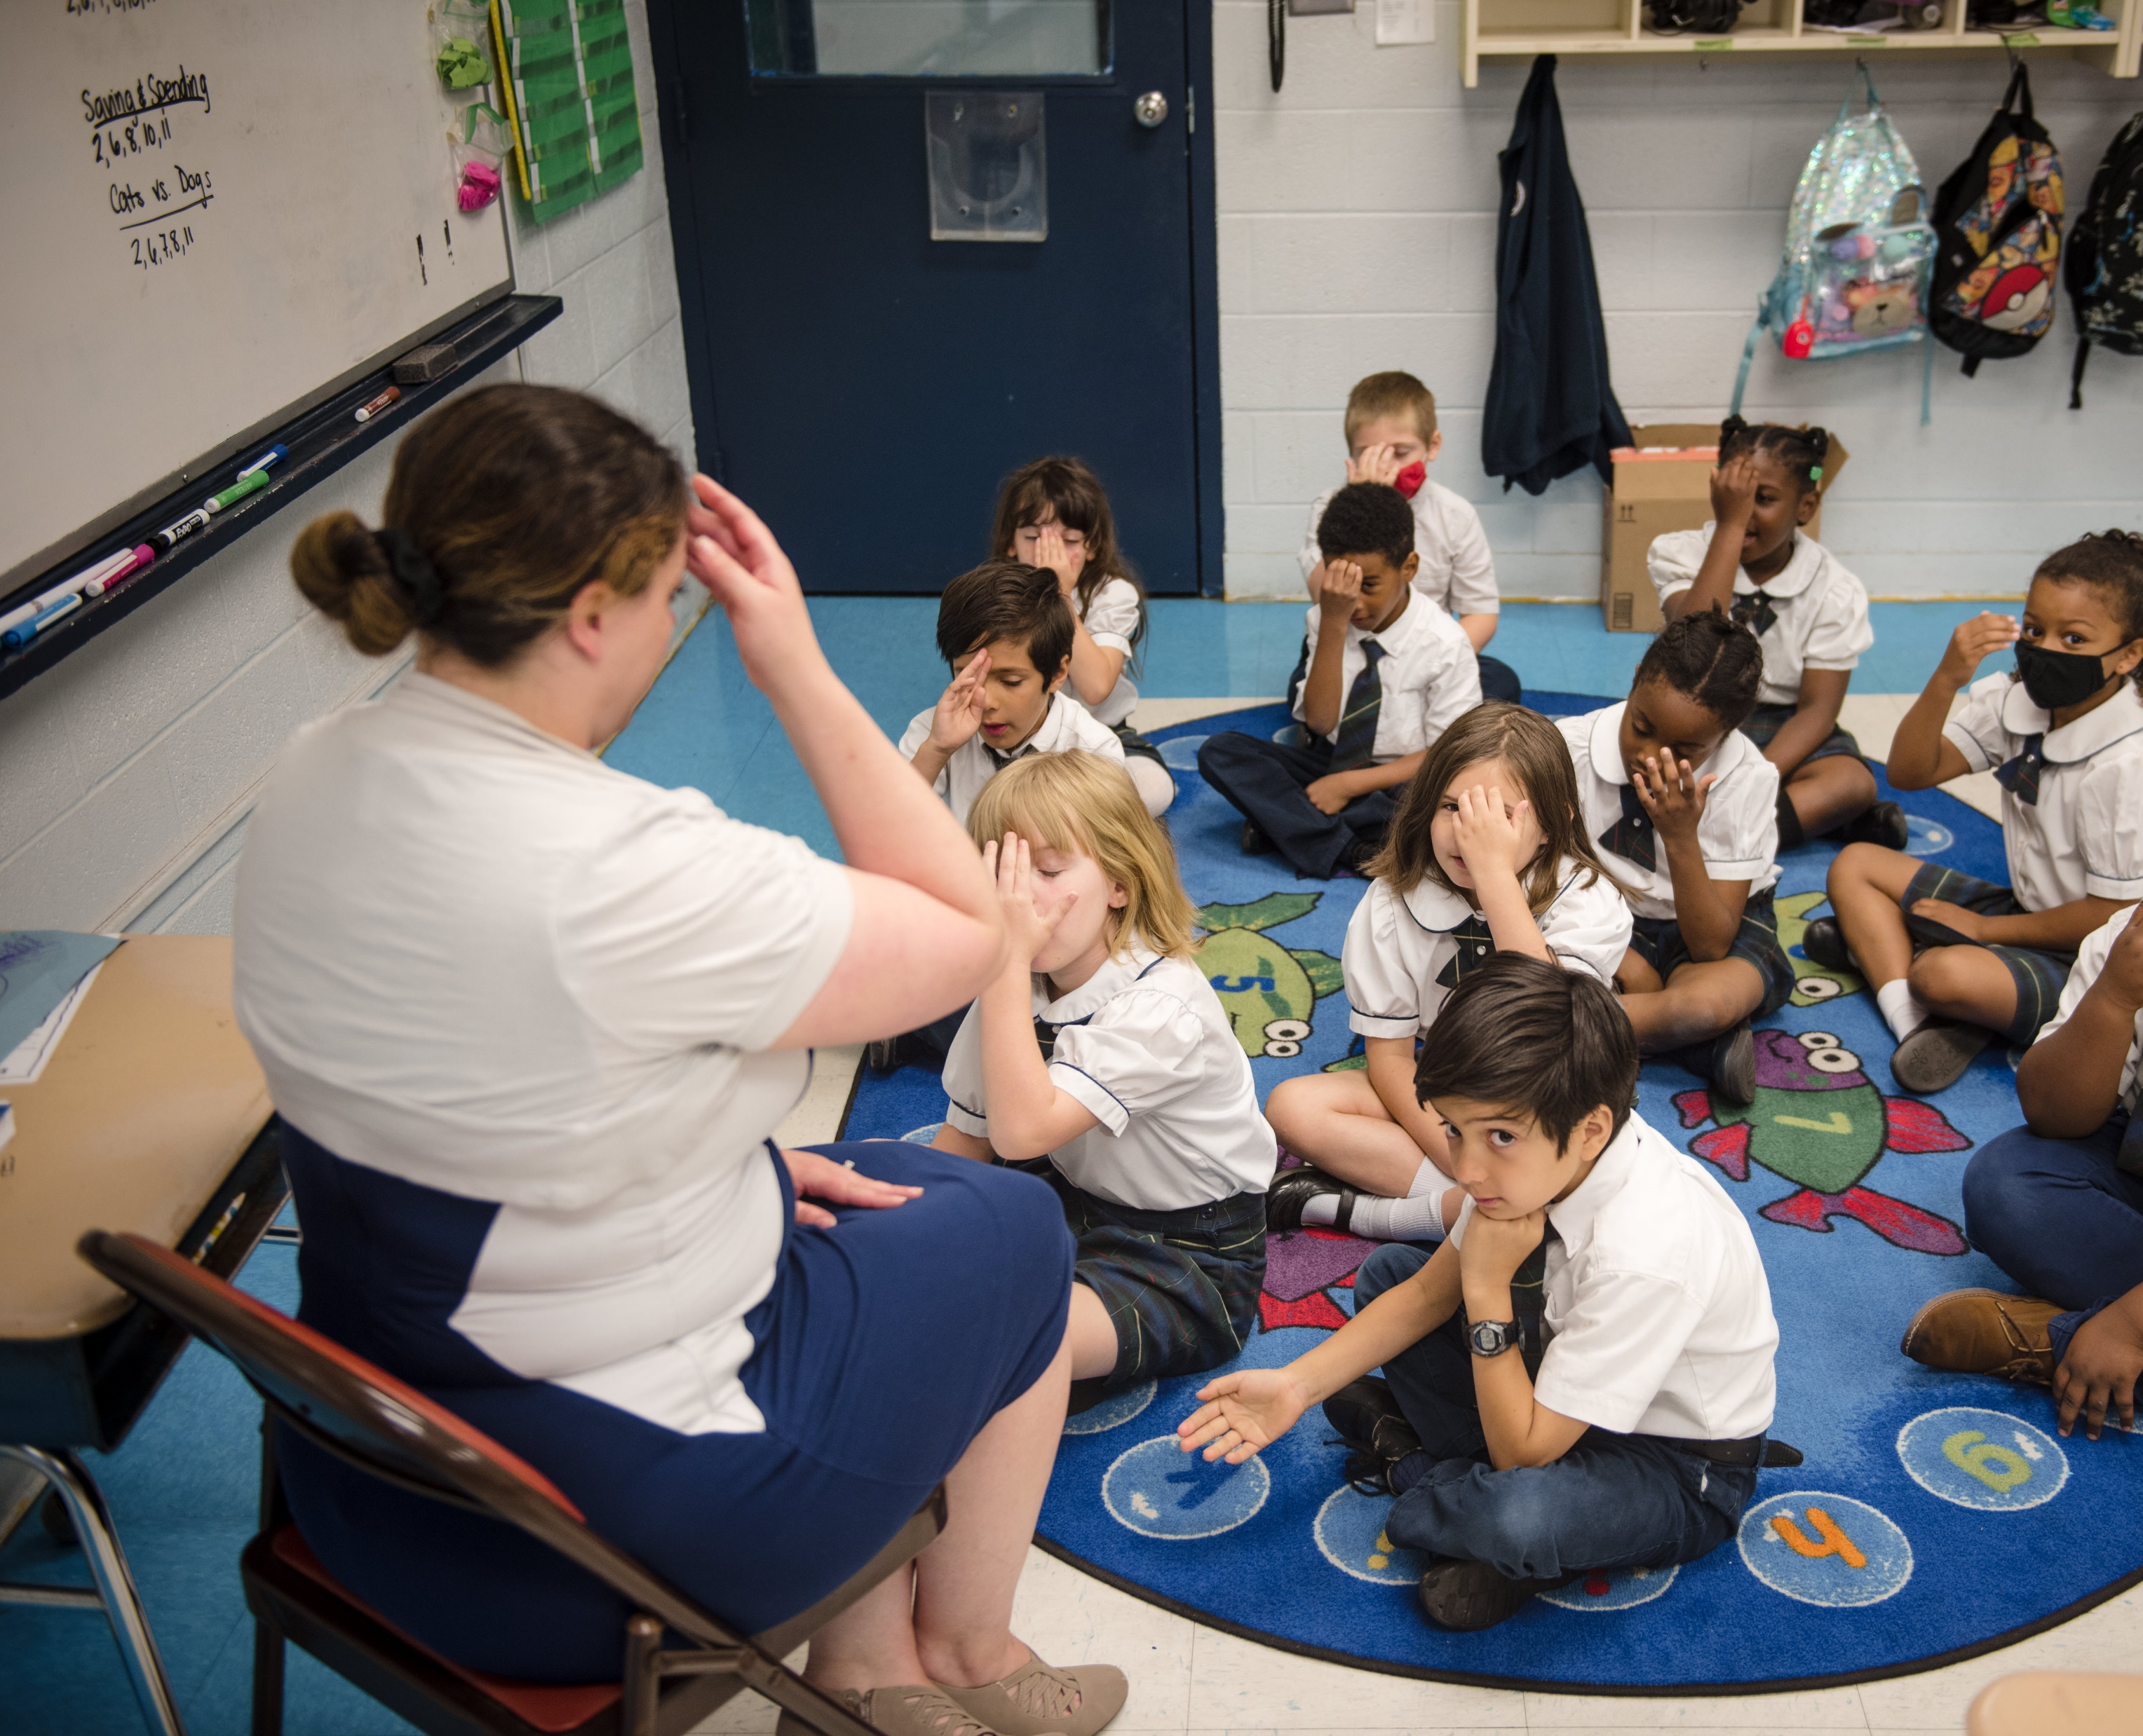
OPERATIONAL VITALITY
Enrollment Management Teams
One day we will:
Be accessible to and inclusive of any student regardless of socio-economic status, race, cultural background, religious affiliation or learning exceptionality.
We will retain and attract students so that every seat in every classroom in every school will be filled.

Slide 6
Dr. James Knight
“Lead with Humility”
James Knight is an educator, coach/ mentor, consultant, author, itinerant speaker/teacher, and equity and inclusion strategist.
James has a passion for people and sees himself as a servant- leader. His personal mission is “education + empowerment = elevation,” and his number one goal in everything he does is to elevate those he serves through education and inspiration.
Much of his work revolves around leading with humility and partnering with other leaders to build dynamic and inclusive communities/spaces where people collaborate, innovate, and engage in fearless dialogue.

Slide 7
OPERATIONAL VITALITY
Enrollment Management Meetings and Topics
Wed. Nov. 15, 10-11am Planning for Catholic Schools Week / Summer Camps for Recruitment and Retention
Wed. Jan. 10, 10-11am Enrollment and Admissions for Operational Vitality
Wed. March 13, 10-11am Social Media Marketing

Slide 8
OPERATIONAL VITALITY
Enrollment Management Training - Questions
One day we will:
Be accessible to and inclusive of any student regardless of socio-economic status, race, cultural background, religious affiliation or learning exceptionality.
We will retain and attract students so that every seat in every classroom in every school will be filled.

Slide 9
Prayer
Loving God,
You are present to us whenever we gather as a faith community.
We pray that our schools will be places where everyone feels accepted, safe, and beloved.
Help our schools and our local communities be places of faith so that we can help others believe in You.
Fill us with Your Spirit so that we may reflect Your light and love to each other and the whole world as one Body of Christ.
We ask this of Jesus, Your Son, who lives and reigns with You, in the unity of the Holy Spirit, one God, forever and ever.
Amen.
Notes:
Prayer before Meetings
Heavenly Father, as we enter into this meeting, we bring your presence with us. We speak your peace, your grace, your mercy, and your perfect order. We acknowledge your power over all that will be spoken, thought, discussed, decided, and done during our meeting.
Lord, we thank you for the gifts you have given to us and we commit to using them responsibly in your honor. Give us a fresh supply of strength and compassion to do our job. Anoint our plans, ideas, and energies so that even our smallest accomplishment may bring you glory.
Lord, when we are confused, guide us, when we are anxious, comfort us, and when we are tired, infuse with the fire of the Holy Spirit.
May the work that we do and the way we do it bring faith, joy, and hope to all of those we serve today and every day.
We ask this through your son, Jesus Christ.
Amen.

