Slide 1

Welcome Principals, Directors and Enrollment Management Team Members

Slide 2

Prayer
Notes:
Prayer before Meetings
Heavenly Father, as we enter into this meeting, we bring your presence with us. We speak your peace, your grace, your mercy, and your perfect order. We acknowledge your power over all that will be spoken, thought, discussed, decided, and done during our meeting.
Lord, we thank you for the gifts you have given to us and we commit to using them responsibly in your honor. Give us a fresh supply of strength and compassion to do our job. Anoint our plans, ideas, and energies so that even our smallest accomplishment may bring you glory.
Lord, when we are confused, guide us, when we are anxious, comfort us, and when we are tired, infuse with the fire of the Holy Spirit.
May the work that we do and the way we do it bring faith, joy, and hope to all of those we serve today and every day.
We ask this through your son, Jesus Christ.
Amen.

Slide 3
Enrollment Management Team Training
Session 1
2022-23

Slide 4

Our Learning Goal…
Enrollment Management Teams
Enrollment Management Team
Members will be able to…
Celebrate current strengths and powerful practices in enrollment
Identify opportunities for growth
Implement immediate steps to recruit and retain students and families

Slide 5

OPERATIONAL VITALITY
Enrollment Management Teams
One day we will:
Be accessible to and inclusive of any student regardless of socio-economic status, race, cultural background, religious affiliation or learning exceptionality.
We will retain and attract students so that every seat in every classroom in every school will be filled.

Slide 6
Why this approach?
The Office of Education invested in researching best practices in enrollment management both locally and nationally.
At successful Catholic schools, enrollment management is the product of planned local teamwork among principals, teachers, parents, and the broader community.
Often, the process of establishing best practices in enrollment management was born out of an enrollment crisis.
Unfortunately, some Catholic schools have not been able to react to such a crisis in a timely or suitable fashion. Enrollment Management Training is designed to help all schools, irrespective of their current enrollment standing, to create and execute a plan for enrollment success.

Slide 7
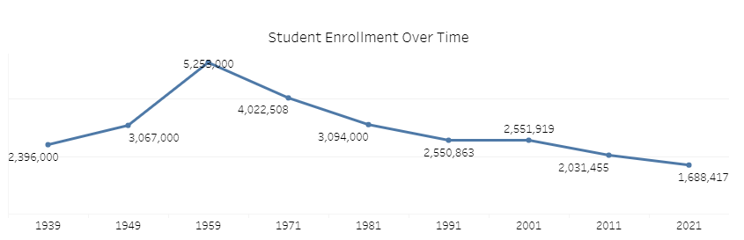
Trends in Catholic Education
Source: https://ncea.org/NCEA/Who_We_Are/About_Catholic_Schools/Catholic_School_Data

Slide 8
Trends in Catholic Education
U. S. Catholic school enrollment reached its peak during the early 1960s when there were more than 5.2 million students in almost thirteen thousand schools across the nation. The 1970s and 1980s saw a steep decline in both the number of schools and students. By 1990, there were approximately 2.5 million students in 8,719 schools. From the mid-1990s through 2000, there was a steady enrollment increase (1.3%) despite continued closings of schools.
In the 10 years since the 2010 school year, 1,400 schools were reported closed or consolidated (19.7%), while 261 school openings were reported. Due to different definitions used by dioceses for consolidations, closings and their transitions into new configurations, along with actual new schools opened, the actual decrease in number of schools since 2010 is 999 (14.3%). The number of students declined by 439,581 (21.3%).
The most seriously impacted have been elementary schools. Since 2010,
elementary school enrollment has declined by 24.8% in the rest of the U.S.

Slide 9

Best Practices Across Dioceses
“If we fail to change the current marketing and advancement strategy, then we have every reason to believe that the downward spiral will continue.” Deacon Bert L’Homme Superintendent of Schools, Archdiocese of Washington
Implementation of an enrollment management plan and effective marketing at Catholic elementary schools is critical to the future of Catholic education.

Slide 10




Models for Success
Diocesan Marketing and Enrollment supports have proven successful in:
Archdiocese of Philadelphia
Diocese of Arlington, VA
Diocese of Lansing, MI
Diocese of Orange County, CA
Diocese of Charlotte, NC
Archdiocese of Seattle
Archdiocese of Washington

Slide 11
Beginning with our Mission

Slide 12

Anchors and Sails
How are our schools ANCHORS?
”This we have as an anchor of the soul, sure and firm…” Hebrews 6:19

Slide 13

Anchors and Sails
How are our schools SAILS?
“…behold, for your sake, God has granted safety to all who are sailing with you.” Acts 24:27

Slide 14
Our efforts must be driven by our MISSION!
“If you lead with Mission, the money will follow.”
- Fr. Michael Martin, OFM
Under the authority of the Bishop, the Office of Education serves the ministry of Catholic schools in the Diocese of Raleigh. Our purpose is to ensure that Catholic Identity remains the foundation of all we do.
We advance the Diocesan shared mission and vision for Catholic schools; foster collaboration, solidarity, and subsidiarity; engage in advocacy for Catholic education; and ensure compliance with laws, policies, and procedures.
In partnership with pastors, principals, and directors, the Office of Education supports schools as they
form disciples and scholars,
strengthen families in faith,
and grow equitable school communities that are affordable, accessible and inclusive.

Slide 15
Team Member Roles

Slide 16
Team Member Roles: Principal
Although the enrollment management process is a high-priority, it is also a potentially time-consuming process. The school’s principal should weigh his or her involvement very carefully. The principal should approve the final composition of the Enrollment Management Team, but can delegate the selection and organization of a trusted leader within the school community to oversee the process.

Slide 17
Team Member Roles: Leader
The principal must select a leader who has strong credibility within the school community and is known as committed, dedicated and enthusiastic promoter of the school.
In addition, the leader must have the people skills necessary not only to organize and direct the team, but also to motivate them and elicit their strong commitment and accountability.
Together with the principal, the leader must be able to identify and recruit the entire Enrollment Management Team, finding the right mix of skills, talents, personalities and experiences.

Slide 18
Team Member Roles: Technical Advisor
A person with the expertise and willingness to
Provide advice on maintaining and updating databases of prospective students/families and spreadsheets that track enrollment data.
This person should be detail-oriented and proficient in EXCEL/Google Sheets

Slide 19
Team Member Roles: Treasurer and/or Finance Expert
An accountant or bookkeeper who can convert the Marketing and Enrollment Plan into a budget which he/she monitors.
One who understands the relationship between tuition increases and attrition rates who can help with the school’s total financial budget projections.

Slide 20
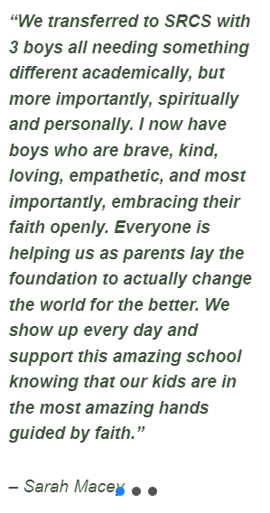
Team Member Roles: Evangelizer
One who naturally makes the connection in the conversation between the “good news” about Catholic education and spreading the Kingdom of God.
This person shares his or her passion and enthusiasm for the faith at every opportunity – a natural word-of-mouth promoter.

Slide 21
Team Member Roles: Public Relations/Marketing Expert
An individual with marketing, advertising or public relations experience who can effectively promote the school’s special events and qualities to the internal school community and to external audiences.
“My degree is in graphic design which led me to the position of Enrollment and Marketing Officer in 2013. Since 2019, that role has included Advancement, all of which are complemented by my graphic design background. I view enrollment and fundraising through the marketing 'lens' with constant analyses of audiences, trends, social media, SEO, and branding. Event planning, for which I am also responsible, is integral to the in-person/on-campus experience which actively
promotes SRCS.”
(Mary Morgan, St. Raphael)

Slide 22

Team Member Roles: Stellar Teacher
The educator every parent wishes his or her child had this year and every year.

Slide 23
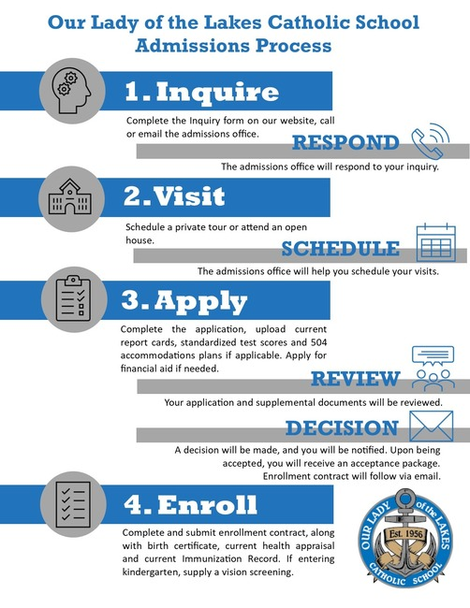
Team Member Roles: Organizer
A highly reliable person willing to track the team’s schedule, budget, and other important information, ensuring it is all done correctly.

Slide 24
Closing Thoughts…

Slide 25

Appreciative Inquiry –
Enrollment Management Teams
What has WORKED WELL for our schools so far?
What could be IMPROVED?
How can we leverage what we already do well to improve other areas?
https://bit.ly/enrollmentteams

Slide 26
OPERATIONAL VITALITY
Enrollment Management Meetings and Topics
Wednesday, November 9, 10am – 12pm: Topic - Marketing
Wednesday, January 11, 10am – 12pm: Topic – Recruiting
Wednesday, March 15, 10am – 12pm: Topic – Retention

Slide 27
OPERATIONAL VITALITY
Enrollment Management Training - Questions
One day we will:
Be accessible to and inclusive of any student regardless of socio-economic status, race, cultural background, religious affiliation or learning exceptionality.
We will retain and attract students so that every seat in every classroom in every school will be filled.

Slide 28
Prayer
Notes:
Prayer before Meetings
Heavenly Father, as we enter into this meeting, we bring your presence with us. We speak your peace, your grace, your mercy, and your perfect order. We acknowledge your power over all that will be spoken, thought, discussed, decided, and done during our meeting.
Lord, we thank you for the gifts you have given to us and we commit to using them responsibly in your honor. Give us a fresh supply of strength and compassion to do our job. Anoint our plans, ideas, and energies so that even our smallest accomplishment may bring you glory.
Lord, when we are confused, guide us, when we are anxious, comfort us, and when we are tired, infuse with the fire of the Holy Spirit.
May the work that we do and the way we do it bring faith, joy, and hope to all of those we serve today and every day.
We ask this through your son, Jesus Christ.
Amen.

